Slide 1
Spectral Clustering
Ng Yen Kaow
Based on the slides on Spectral Clustering in CMU’s Machine Learning course
http://www.cs.cmu.edu/~aarti/Class/10701/slides/Lecture21_2.pdf

Slide 2
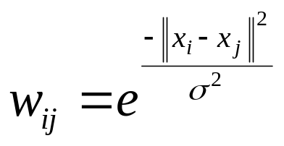
Similarity graph
Consider the points in the feature space as a graph
Each edge is given a weight
  Larger weight ⇔ similar
  Lower weight ⇔ dissimilar
    1/ || x_{i} − x_{j} ||²
    Gaussian kernel similarity function

Slide 3
Similarity graph
Consider the points in the feature space as a graph
Each edge is given a weight
  Larger weight ⇔ similar
  Lower weight ⇔ dissimilar
Idea: remove edges with low weights

Slide 4
Similarity graph
Consider the points in the feature space as a graph
A strongly connected partition has high total weights
Each edge is given a weight
  Larger weight ⇔ similar
  Lower weight ⇔ dissimilar
Idea: remove edges with low weights
Partition the vertices such that the “sum of the weights between two different partitions” is small
Removed edges have low total weights

Slide 5
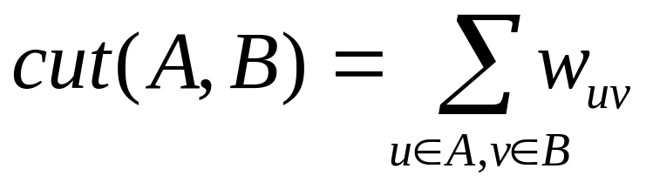
Idea 1: Min-cut
Denote the similarity between vertex u and vertex v as w_{uv}
For partitions A and B, let
Find a partitioning which minimizes cut(A, B)

Slide 6
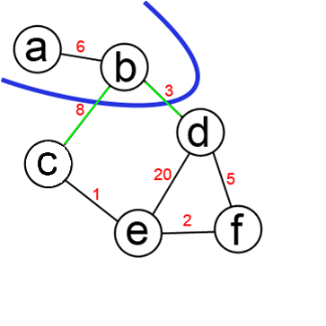
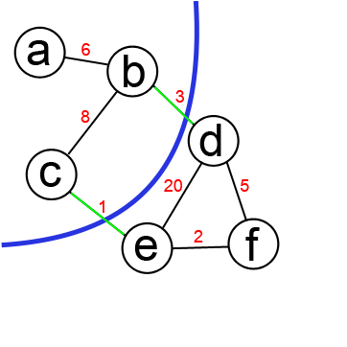
Idea 1: Min-cut
Cut: set of edges whose removal disconnects G
Min-Cut: a cut in G of minimum cost
Weight of this cut: 11 Weight of min cut: 4

Slide 7
Idea 1: Min-cut
s-t cut: cut with s and t in different partitions
s = a and t = d
Weight of this a-d cut: 11 Weight of min a-d cut: 4

Slide 8
Idea 1: Min-cut
Check every possible cut
Number of partitioning to check: O(2^{n})

Slide 9
Idea 1: Min-cut
Ford-Fulkerson, 1956
  Input: Directed Graph with weights on edges and two vertices s and t
  Output: Directed min cut between s and t
Running time: O(n⁴)
Make edges bidirected
Fix an s, try all other vertices as t
Return the lowest cost solution

Slide 10
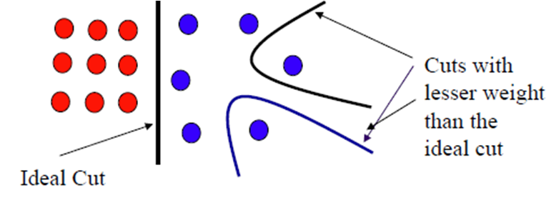
Idea 1: Min-cut
Problem

Slide 11
Idea 2: Normalized Cut
Consider the points in the feature space as a graph
A strongly connected partition has high total weights
Each edge is given a weight
  Larger weight ⇔ similar
  Lower weight ⇔ dissimilar
Idea: remove edges with low weights
Partition the vertices such that the “sum of the weights between two different partitions” is small
Removed edges have low total weights
compared to the general weights between vertices

Slide 12
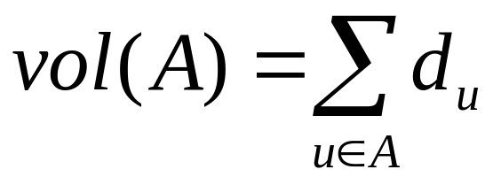
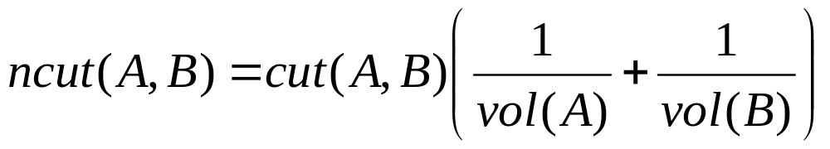
Normalized cut
Denote the similarity between vertex u and vertex v as w_{uv}
For partitions A and B, let

Slide 13
Normalized cut
The problem is to find partitions A and B such that ncut(A, B) is minimized
  Problem is NP-hard (by Papadimitriou), but can be approximately solved using “Spectral Clustering” (Shi and Malik, 2000)
Spectral clustering
  Typically means the following tricks
    Graph Laplacian
    Lanczos algorithm
    k-means clustering (Lyold’s algorithm)

Slide 14
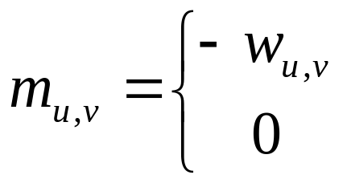
Graph Laplacian
Laplacian Matrix (aka Kirchhoff matrix)
  Symmetric
  Diagonal elements m_{u,u} = Degree of vertex u
  Other elements
If edge (u, v) exists
Otherwise
1
B
A
 | A | B | C | D | E
A | 2 | -1 | 0 | 0 | -1
B | -1 | 2 | -1 | 0 | 0
C | 0 | -1 | 2 | 0 | -1
D | 0 | 0 | 0 | 1 | -1
E | -1 | 0 | -1 | -1 | 3
1
1
E
C
1
1
D
Laplacian matrix

Slide 15
Graph Laplacian
Colab codes to read demo file
# Copy example file from GCP
from google.colab import auth
auth.authenticate_user()
project_id = 'twitter-for-bigquery'
!gcloud config set project {project_id}
!apt-get install -y -qq software-properties-common python-software-properties module-init-tools
!gsutil copy -r gs://harddisk-1/specclus.csv .
# Read example file
import numpy as np
distmat = np.genfromtxt('specclus.csv', dtype=float, delimiter=",")
# Show
distmat

Slide 16
Graph Laplacian
Python codes to construct diagonal elements
Python codes to construct the other elements
Python codes to construct the Laplacian
adjmat = np.copy(distmat)
adjmat[_distmat != 0] = 1
degree = adjmat.sum(axis=0)-1
D = np.zeros(distmat.shape)
row, col = np.diag_indices(adjmat.shape[0])
D[row, col] = degree
W = np.copy(distmat)
np.fill_diagonal(W, 0)
L = D - W

Slide 17
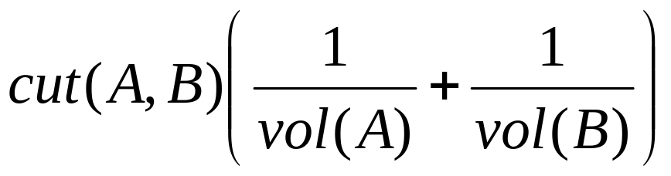
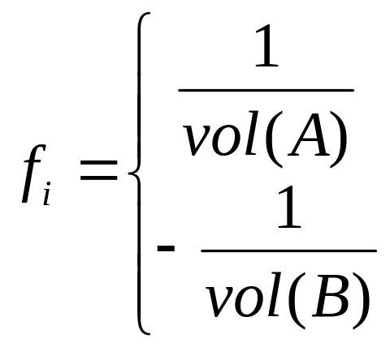
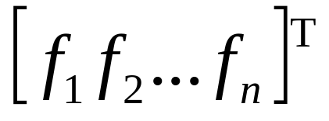
Graph Laplacian
What’s so interesting about the graph Laplacian?
Recall that ncut(A, B) =
Let f = with
That is, each element f_{i} of the vector f encodes the membership of the i-th vertex in the clustering
if i ∈ A
if i ∈ B

Slide 18
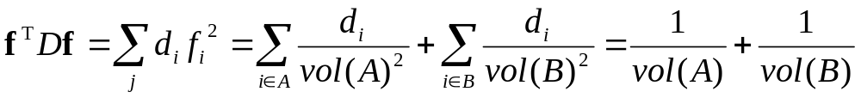
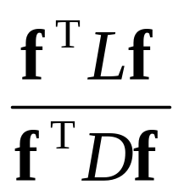
Graph Laplacian
What’s so interesting about the graph Laplacian?
Recall that ncut(A, B) =
Then, the following holds
That means,
ncut(A, B) =

Slide 19
Graph Laplacian
What’s so interesting about the graph Laplacian?
Recall that ncut(A, B) =
min ncut(A, B) = min
ncut(A, B) =

Slide 20
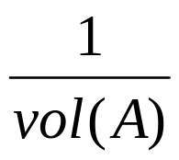
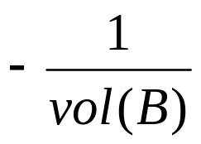
Graph Laplacian
What’s so interesting about the graph Laplacian?
Recall that ncut(A, B) =
It suffices that we solve f which minimizes
However, this is difficult to solve if f_{i} is constrained to
only the values or
min ncut(A, B) = min

Slide 21
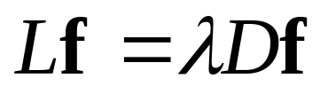
Graph Laplacian
What’s so interesting about the graph Laplacian?
Recall that ncut(A, B) =
By allowing f_{i} to take on any real value, the problem can be reduced to one of solving the eigenvector system of
Eigendecomposition of normalized Laplacian D^{−1/2}LD^{−1/2}
min ncut(A, B) = min

Slide 22
Graph Laplacian
Normalized Laplacian D^{−1/2}LD^{−1/2}
Eigendecompose the normalized Laplacian
from math import sqrt
nL = np.zeros(L.shape)
for i in range(len(nL)):
for j in range(i+1, len(nL)):
val = L[i,j]/sqrt(L[i,i]*L[j,j])
nL[i,j] = val
nL[j,i] = val
np.fill_diagonal(nL, 1)
eigenvalues, eigenvectors = np.linalg.eig(nL)
idx = eigenvalues.argsort()[::-1]
eigenvalues = eigenvalues[idx]
eigenvectors = eigenvectors[:,idx]
print(eigenvectors)
print(eigenvalues)

Slide 23
Demo

Slide 24
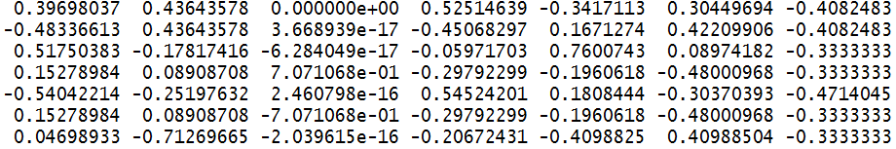
Eigendecomposition of D^{−1/2}LD^{−1/2}
Eigenvectors:
1 2 3 4 5 6 7
Eigenvalues:
1.75 1.5 1.5 1.147 8.26x10⁻⁰¹ 2.76x10⁻⁰¹ near 0
7
 | 1 | 2 | 3 | 4 | 5 | 6 | 7
1 | 1 | -0.33 | 0 | 0 | -0.29 | 0 | -0.41
2 | -0.33 | 1 | -0.41 | 0 | 0 | 0 | -0.41
3 | 0 | -0.41 | 1 | 0 | -0.35 | 0 | 0
4 | 0 | 0 | 0 | 1 | -0.35 | -0.5 | 0
5 | -0.29 | 0 | -0.35 | -0.35 | 1 | -0.35 | 0
6 | 0 | 0 | 0 | -0.5 | -0.35 | 1 | 0
7 | -0.41 | -0.41 | 0 | 0 | 0 | 0 | 1
1
2
5
3
4
6

Slide 25
Eigendecomposition of D^{−1/2}LD^{−1/2}
Eigenvectors:
1 2 3 4 5 6 7
Eigenvalues:
1.75 1.5 1.5 1.147 8.26x10⁻⁰¹ 2.76x10⁻⁰¹ near 0
7
 | 1 | 2 | 3 | 4 | 5 | 6 | 7
1 | 1 | -0.33 | 0 | 0 | -0.29 | 0 | -0.41
2 | -0.33 | 1 | -0.41 | 0 | 0 | 0 | -0.41
3 | 0 | -0.41 | 1 | 0 | -0.35 | 0 | 0
4 | 0 | 0 | 0 | 1 | -0.35 | -0.5 | 0
5 | -0.29 | 0 | -0.35 | -0.35 | 1 | -0.35 | 0
6 | 0 | 0 | 0 | -0.5 | -0.35 | 1 | 0
7 | -0.41 | -0.41 | 0 | 0 | 0 | 0 | 1
1
2
5
3
4
6
Fact
Fact
The eigenvector with the 2nd smallest eigenvalue minimizes
2nd smallest eigenvalue

Slide 26
Eigendecomposition of D^{−1/2}LD^{−1/2}
Eigenvectors:
1 2 3 4 5 6 7
Eigenvalues:
1.75 1.5 1.5 1.147 8.26x10⁻⁰¹ 2.76x10⁻⁰¹ near 0
7
 | 1 | 2 | 3 | 4 | 5 | 6 | 7
1 | 1 | -0.33 | 0 | 0 | -0.29 | 0 | -0.41
2 | -0.33 | 1 | -0.41 | 0 | 0 | 0 | -0.41
3 | 0 | -0.41 | 1 | 0 | -0.35 | 0 | 0
4 | 0 | 0 | 0 | 1 | -0.35 | -0.5 | 0
5 | -0.29 | 0 | -0.35 | -0.35 | 1 | -0.35 | 0
6 | 0 | 0 | 0 | -0.5 | -0.35 | 1 | 0
7 | -0.41 | -0.41 | 0 | 0 | 0 | 0 | 1
1
2
5
3
4
6
Cluster 1
Cluster 2

Slide 27
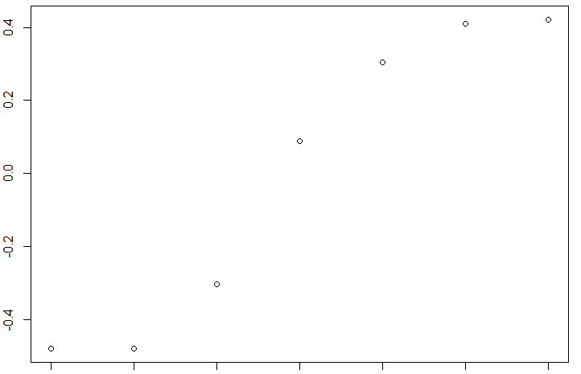
Eigendecomposition of D^{−1/2}LD^{−1/2}
Eigenvectors:
1 2 3 4 5 6 7
Eigenvalues:
1.75 1.5 1.5 1.147 8.26x10⁻⁰¹ 2.76x10⁻⁰¹ near 0
7
7
2
Cluster 1
1
1
3
2
5
Cluster 2
3
5
4
6
4
6
Shown from smallest to largest

Slide 28
Eigendecomposition of D^{−1/2}LD^{−1/2}
Recall that we originally wanted
That is, we originally wanted f_{i} to be the same for all the elements i in the same cluster, but relaxed this condition
7
7
2
Cluster 1
1
1
3
2
5
Cluster 2
3
5
4
6
4
6
if i ∈ A
if i ∈ B

Slide 29
Eigendecomposition of D^{−1/2}LD^{−1/2}
Eigenvectors:
1 2 3 4 5 6 7
Eigenvalues:
1.75 1.5 1.5 1.147 8.26x10⁻⁰¹ 2.76x10⁻⁰¹ near 0
7
7
2
1
1
3
2
5
3
5
4
6
4
6
The other eigenvectors further distinguishes the elements within the same cluster

Slide 30
Partitioning a graph into k clusters
Two methods
  Recursively two-partitions the vertices
  Use k eigenvectors with the smallest eigenvalues in a single decomposition for clustering
    Apply k-means clustering

Slide 31
Partitioning a graph into k clusters
Suppose k=3, and the eigenvectors are
Eigenvectors:
1 2 3 4 5 6 7
Eigenvalues:
1.75 1.5 1.5 1.147 8.26x10⁻⁰¹ 2.76x10⁻⁰¹ near 0

Slide 32
Partitioning a graph into k clusters
Suppose k=3, and the eigenvectors are
Eigenvectors:
1 2 3 4 5 6 7
Eigenvalues:
1.75 1.5 1.5 1.147 8.26x10⁻⁰¹ 2.76x10⁻⁰¹ near 0

Slide 33
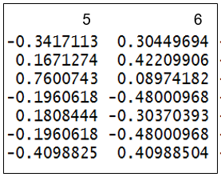
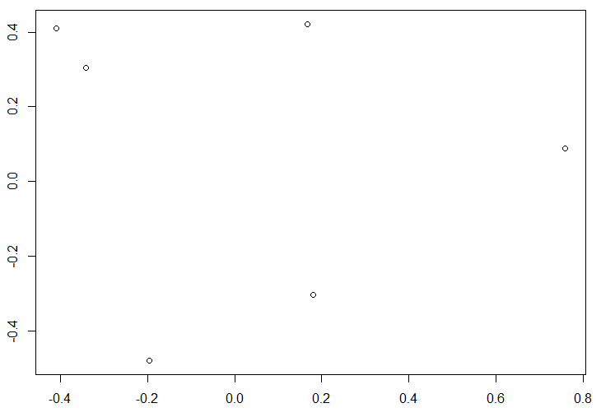
Partitioning a graph into k clusters
Consider the i-th row as the features of vertex i
7
2
1
3
It suffices that we cluster these points in R^{k}
7
1
2
5
5
3
4
6
4
6

Slide 34
k-means clustering
k is a user-chosen parameter
k-means clustering separates the points to k clusters
Feature 2
Feature 2
Feature 1
Feature 1

Slide 35
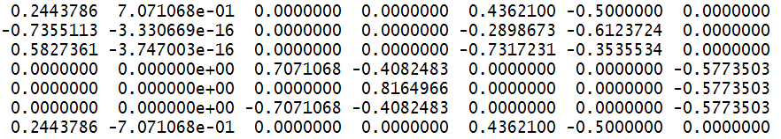
Advantages of spectral clustering
Disconnected graph are naturally solved
  If graph is connected, the smallest eigenvector is constant
  If graph is disconnected, the smallest eigenvector has different values for the disconnected components
7
1
2
5
3
4
6
Eigenvectors:
1 2 3 4 5 6 7

Slide 36
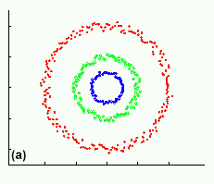
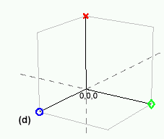
Advantages of spectral clustering
Application of spectral clustering is not limited to graphs
Helps at situations where k-means clustering fails
  Data are projected into a lower-dimensional space (the spectral/eigenvector domain) where they are separable
Original data
Projected data
Graph has 3 connected components: the connected components have the same values in the first eigenvector

Slide 37
Other uses of the Laplacian
Connectedness
Regularity

Slide 38
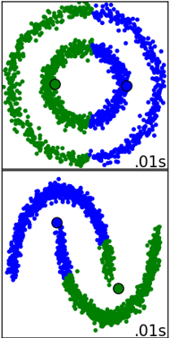
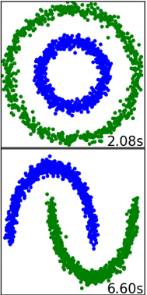
Advantages of spectral clustering
Application of spectral clustering is not limited to graphs
Helps at situations where k-means clustering fails
  Data are projected into a lower-dimensional space (the spectral/eigenvector domain) where they are separable
k-means
Spectral
Clustering

Slide 39
Lanczos method
Last but not least, it should be mentioned that eigendecomposition is expensive
  Calculation of Laplacian’s eigenvectors is bottleneck for large |V|
Lanczos method is often used
  Iterative algorithm for approximating eigenvalues of a square matrix

